Slide 1
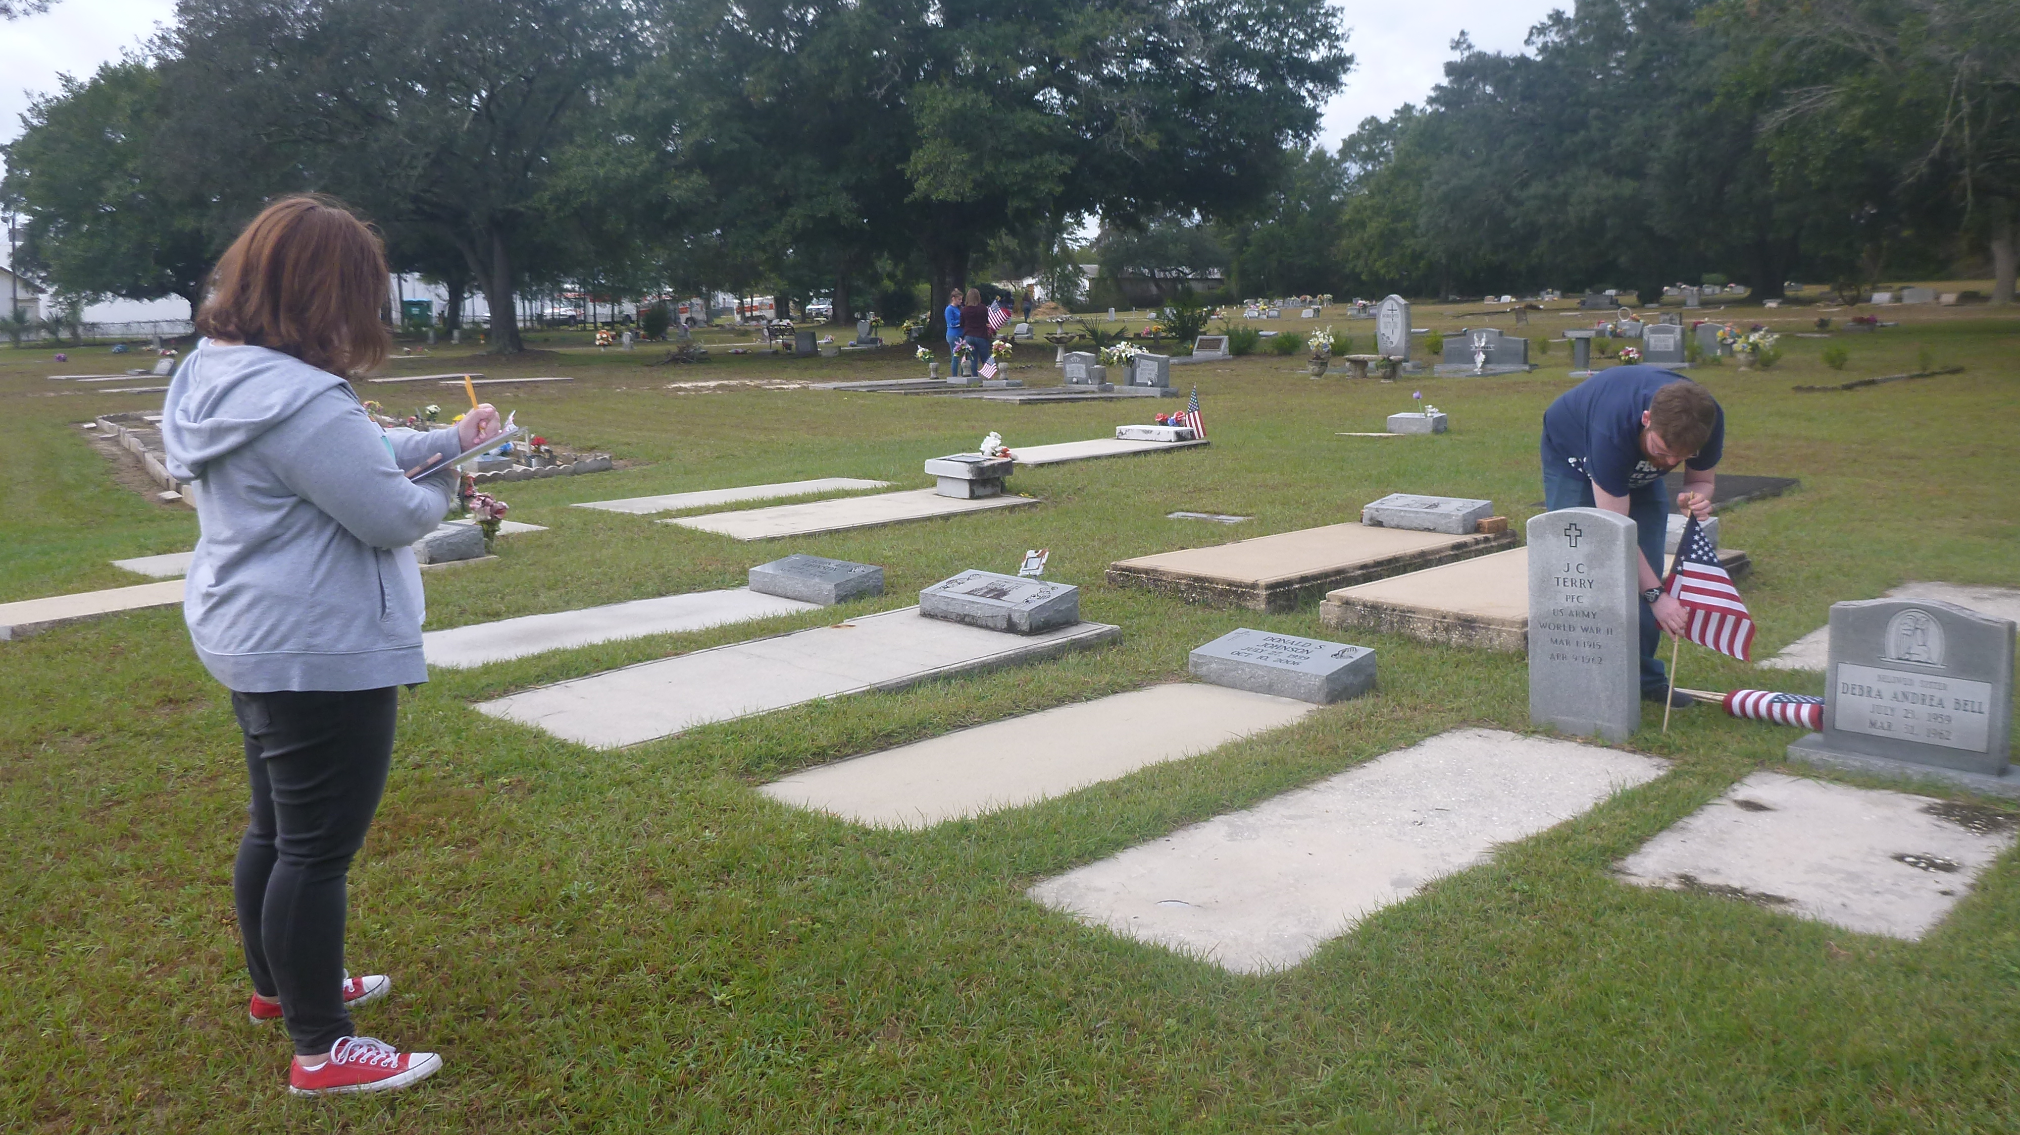

G.R.A.V.E.
Gravestone Research and Volunteer-based education
Notes:
Customize this slide as you see fit

Slide 2

Draw your final resting place
Notes:
Have students draw their “final resting place.” Encourage creativity and try not to let your own ideas about cemeteries or burial places influence their drawings. Have students share their drawings, either in pairs or with the class if time permits.

Slide 3
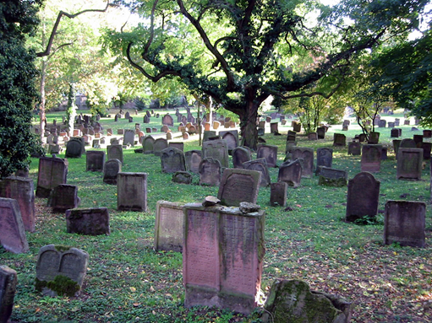
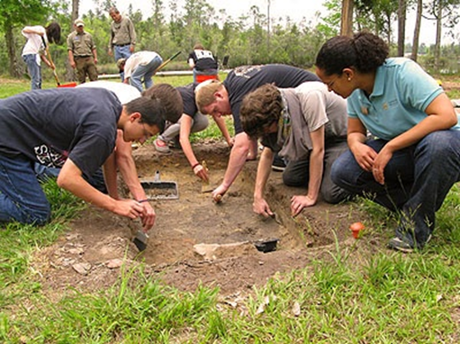
Introduction to Cemeteries
Are cemeteries considered archaeological sites?
Yes, historic cemeteries are archaeological sites.
Archaeologists study human culture through
material remains – anything left behind by
human beings.
Excavation is commonly associated with
archaeology, but archaeologists use other
tools to study past behavior as well.
Even items on the surface of the ground, like
headstones in cemeteries, are studied by
archaeologists.
Notes:
Are cemeteries considered archaeological sites? Yes, historic cemeteries are archaeological sites! Archaeologists aren’t necessarily the first people that come to mind when thinking about cemeteries, but they do study cemeteries, both above ground and below.
Archaeologists study human culture through material remains- anything left behind by human beings. Excavation (digging) is commonly associated with archaeology, but archaeologists use other tools to study past behavior as well. Even items on the surface of the ground, like headstones in cemeteries, are studied by archaeologists.
Ask students who has been to a cemetery. Bring up local cemeteries or famous cemeteries, like Arlington National Cemetery in D.C. or the New Orleans cemeteries.
If students ask, archaeology is different from paleontology (the study of fossils, including dinosaurs) and from geology, the study of rocks. Archaeologists only study things made, used, or modified by humans.
Top image courtesy of Wikipedia.
Bottom image courtesy of FPAN.

Slide 4
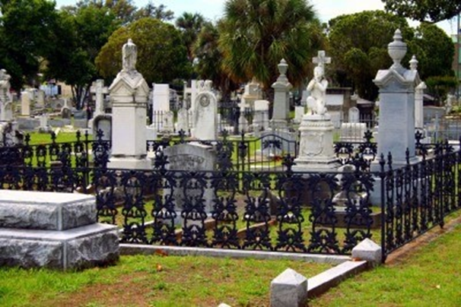
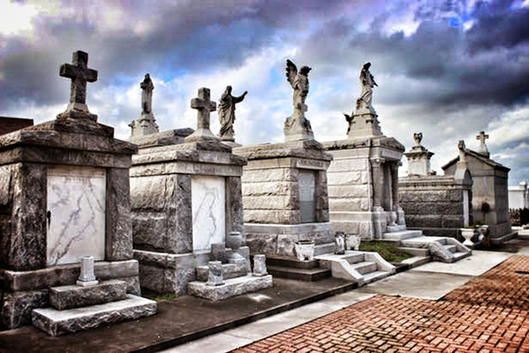
Introduction to Cemeteries
Archaeologists view historic cemeteries as
“outdoor museums,” full of information
about people from the past and gravestones
as primary sources that can be examined like
historical documents.
Cemeteries are often thought of as “spooky”
places, but in the past, they were seen as
parks to visit loved ones.
In addition to providing information about a
historical population and serving as “final
resting places,” cemeteries are very beautiful
and are even tourist destinations.
Notes:
Archaeologists view historic cemeteries as “outdoor museums,” full of information about people from the past, and gravestones as primary sources that can be examined like historical documents.
Ask students if they have been to a museum and to share their experiences with a partner or with the class.
Cemeteries are often thought of as “spooky” places, but in the past they were seen as park-like places to visit loved ones. In addition to providing information about a historical population and serving as “final resting places,” cemeteries can be very beautiful and even serve as tourist destinations (like St. Michael’s Cemetery in Pensacola shown in the upper picture, which is actually a state park, and the New Orleans cemeteries, shown in the lower picture.)
Top image courtesy of Pinterest.
Bottom image courtesy of Blue Sky Traveler.

Slide 5
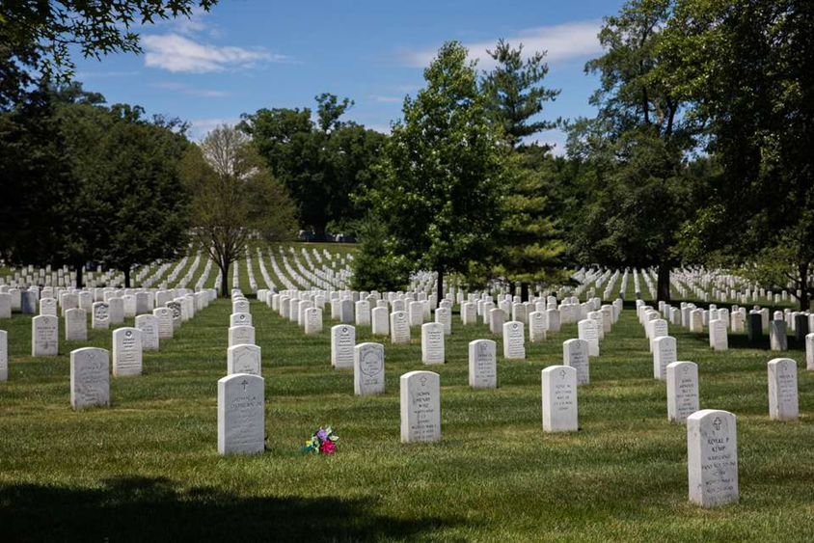
What can we learn from Cemeteries?
Historical sources address big events but often leave out information about day to day life or the interests and beliefs of a population.
Headstones can fill in these gaps and provide us with other perspectives.
Notes:
What can cemeteries tell us?
Historical sources often address big events and sometimes leave out information about what day to day life was like or what the interests and beliefs of a population were.
Many perspectives are typically left out of the primary historical narrative, like those of women or minority groups. Headstones can fill in the gaps in the documentary record to provide information about non-dominant perspectives or those of the average person.
Ask students: “What kinds of information can we learn from cemetery markers?”
Photo of Arlington National Cemetery courtesy of www.tripsavvy.com

Slide 6
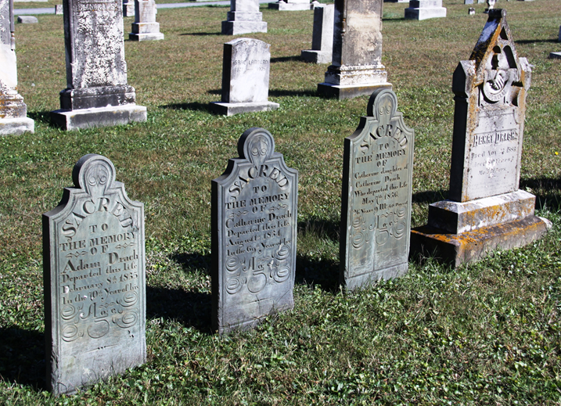
What can we learn from Headstones?
Decorative and symbolic significance
Biographical information
Familial relationships
Fraternal affiliations
Occupational information
Economic status
Cultural or religious beliefs
Notes:
These are some of the types of information we can learn from individual headstones:
• decorative and symbolic significance
• biographical information
• familial relationships
• fraternal or social affiliations (like the Freemasons)
• occupational information
• Economic status
• Cultural or religious beliefs
As you introduce these elements, ask students to think of examples from their drawings or call attention to them yourself (i.e. pointing out any religious or secular symbols they might draw on their markers, calling attention to biographical information, such as age, name, family members, etc.)
Photo courtesy of Maryland Historical Trust.

Slide 7
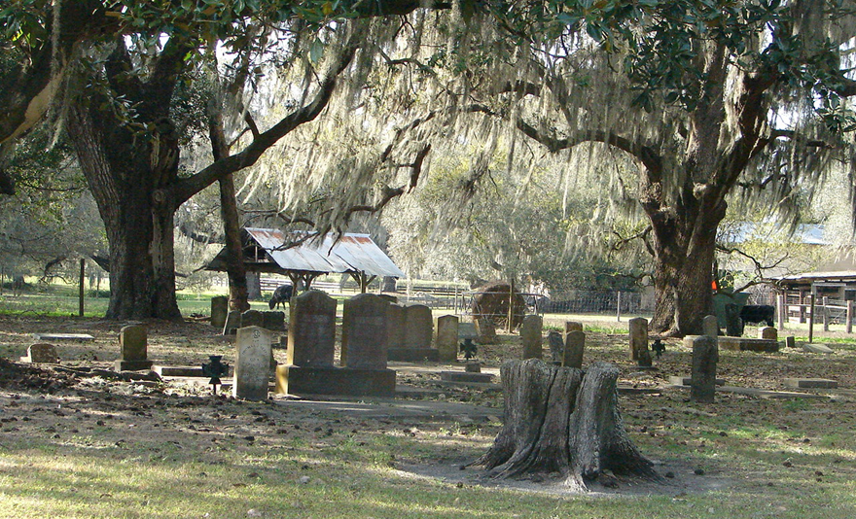
Why should we study Cemeteries?
To protect and preserve burial grounds
To collect information about past populations
To learn the stories these historical places can tell
To prevent neglect, vandalism, and development
Notes:
Why is it important to study cemeteries? Many would argue we have a moral and ethical responsibility to protect and preserve burial grounds. Additionally, cemeteries contain abundant information about past populations, both above ground, through grave markers and monuments, and below ground, through skeletal remains. They are historical places with stories to tell. Finally, many cemeteries face a number of threats and run the risk of being forgotten or developed.
Photo courtesy of Find A Grave.

Slide 8
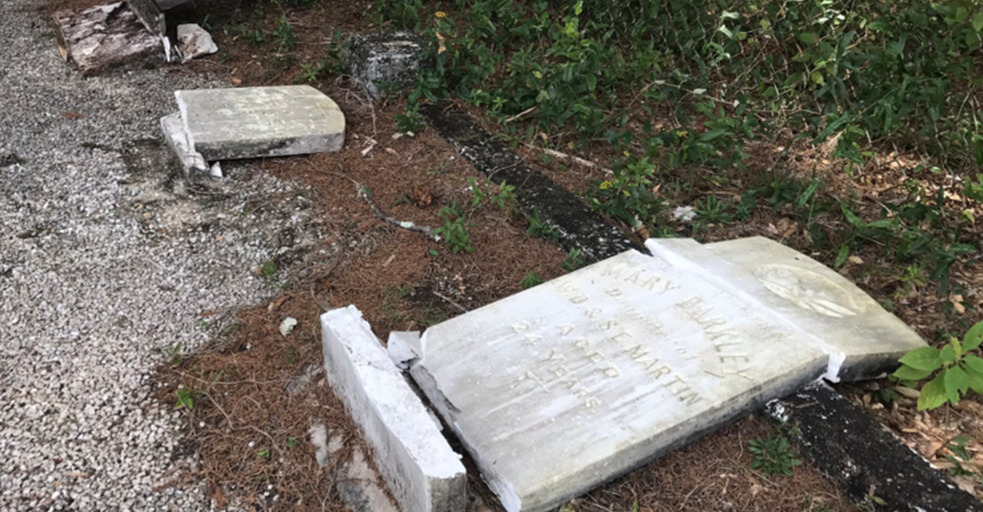
Cemetery Vandalism
Notes:
A major threat to historic cemeteries is vandalism. This is a picture of the Milton Historic Cemetery in Milton, FL, where 30+ graves were knocked over in Fall 2017.
By maintaining cemeteries and showing people why they are important, historic places, you can help prevent vandalism. Additionally, in the unfortunate instances when headstones are totally destroyed or stolen, you will have recorded valuable information about what they said so that history is not lost.
Photo courtesy of WEAR TV.

Slide 9
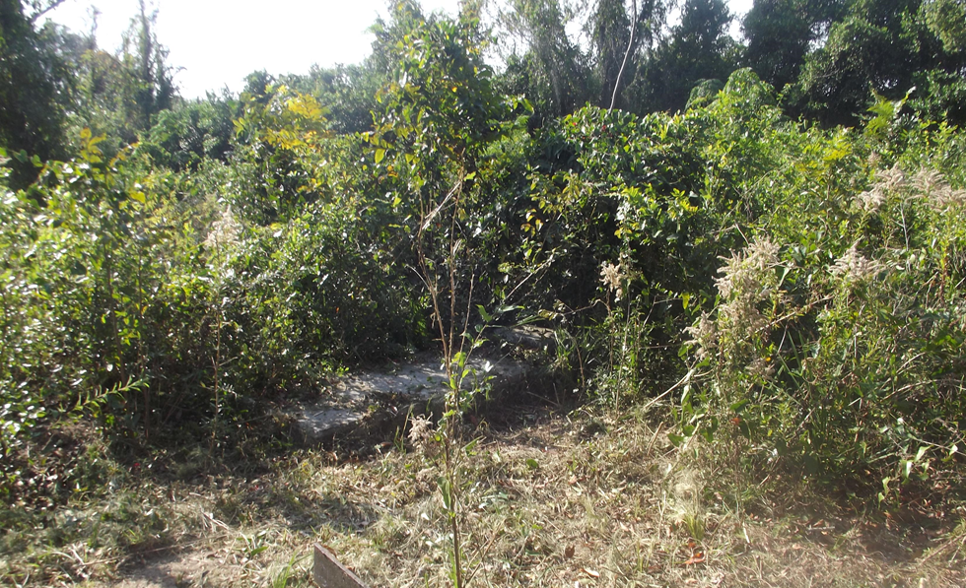
Cemetery Neglect
Notes:
Neglect is another major threat to historic cemeteries. Many of Florida’s cemeteries are abandoned or neglected. When residents move away, churches close, or people begin burying their loved ones in newer cemeteries, older cemeteries are sometimes forgotten and can become overgrown
This picture shows Mt Zion cemetery in Pensacola, which the University of West Florida has begun to clean-up and maintain. Your work can help record these cemeteries and draw attention to their importance.
Ask students: “Have you seen any abandoned or neglected cemeteries in your neighborhood? Do you know who is responsible for caring for them?”
If students know of abandoned cemeteries, they can look up property ownership on the county Property Appraiser website.
Photo courtesy of Find A Grave.

Slide 10
How can you help?
Federal, state, & local laws protect cemeteries on public lands.
On private land, it is the responsibility of the land owner.
Florida law allows local governments to care for cemeteries that have been abandoned for over six months.
The Florida Master Site File is a list of all historic properties in the state of Florida. This list is consulted during development projects.
Many known sites are not listed on the file, including a large number of Florida’s historic cemeteries.
Projects like ours are important to ensure all historic cemeteries are recorded and preserved.
Notes:
There are a number of federal, state, and local laws protecting cemeteries on public lands; however, on private land, cemetery maintenance is the responsibility of the land owner. Sometimes, land owners don’t have the ability to maintain the grounds, and at times they don’t even know they are responsible for its upkeep. Florida law allows local governments to care for cemeteries that have been abandoned for over six months.
The Florida Master Site File is a list of all historic properties in the state of Florida, including historic buildings, archaeological sites, and historic cemeteries. This list is consulted during development projects to determine whether any historic properties would be impacted by construction projects. However, many known sites are not listed on the file, including a large number of Florida’s historic cemeteries. Projects like ours are important to ensure all historic cemeteries are recorded and protected.
If students ask: Though the Florida Master Site File doesn’t offer legal protection for listed sites, it does ensure that impacts to the properties are considered and mitigated during publicly funded development projects

Slide 11
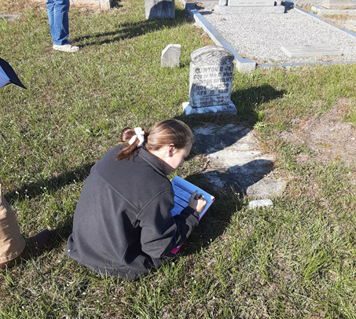
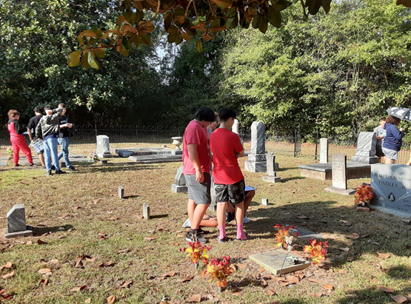
What will we be doing?
Learning new skills
Recording Headstones:
  Transcribing Information
  Sketching Symbols
  Mapping Locations
Analyzing our Results
We will not do any excavation while we’re in the cemetery.
We will study what’s above ground to understand the history of our local community
Notes:
Through this project, we will:
1. Learn new skills in the classroom
2. Visit the cemetery to record headstones
3. Analyze the information we collected after the trip
We won’t be doing any excavation while we’re in the cemetery. We will focus on studying what’s above ground, like grave markers, to understand the history of our local community. In this class we learn about different cultures. This is a way to learn about our own culture.
Photos courtesy of FPAN.

Slide 12
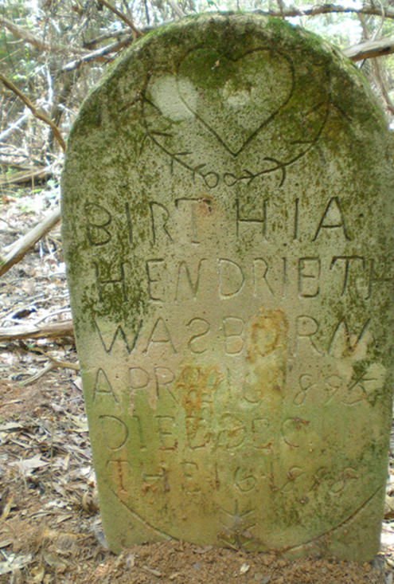
Gravestones as Historical
Documents
1. Analyze the writing
2. Interpret the symbols
3. Look at the overall stonework for clues
Notes:
Gravestones can be read just like other historical documents. There are three primary ways to examine them:
1. Analyze the writing
2. Interpret the symbols
Look at the stone for clues
Photo courtesy of FPAN.

Slide 13
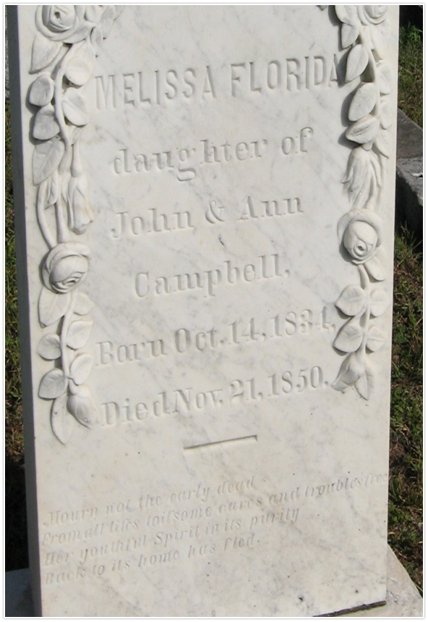
Step 1: Analyze the Writing
Name
Other family members
Date born
Date died
Age
Notes:
Analyze the Writing: Just from this simple marker, we can collect biographical information, including: a person’s name (Melissa Florida), their family members’ names (John and Ann Campbell), the date they were born (October 14, 1834), the date they died (November 21, 1850), and their age (16).
Photo courtesy of FPAN.

Slide 14
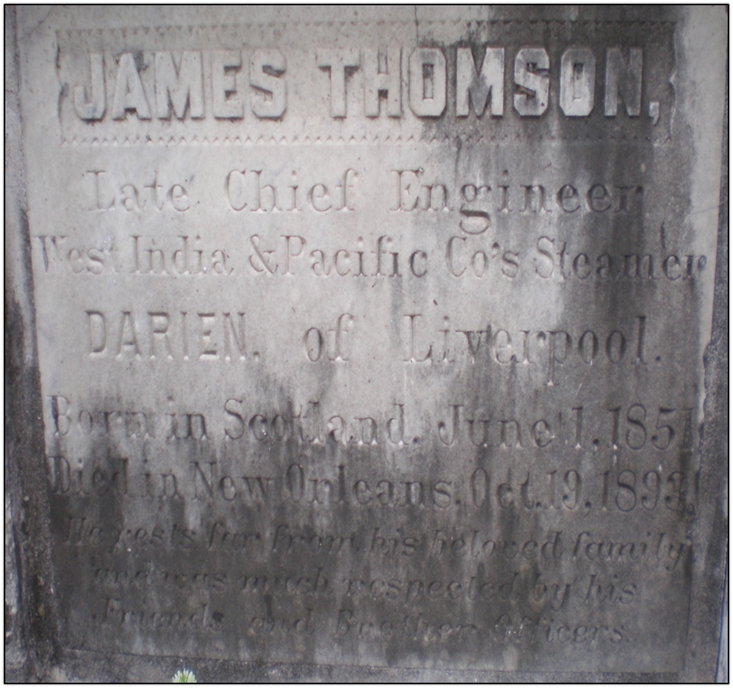
Notes:
What can we learn from this marker? Students should point out name (James Thomson), occupation (Late Chief Engineer for West India and Pacific Company ship named Darien), birthplace (Scotland) birth date (June 1, 1851), death place (New Orleans), death date (October 19, 1893), and age (42)
Ask students: “What information could someone learn about you from your final resting place drawing?”
Photo courtesy of FPAN.

Slide 15
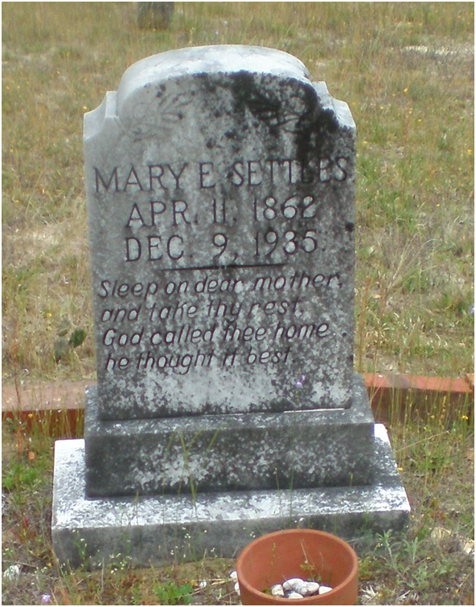
Epitaphs
An epitaph is a short text honoring a deceased person.
What can this epitaph tell us?
“Sleep on dear mother and take thy rest
God called thee home, he thought it best”
She was a mother
She was religious, probably Christian
Her death was likely peaceful
Notes:
Sometimes, graves contain epitaphs, which are short texts honoring a deceased person. These can be analyzed for clues into a person’s qualities as well.

Slide 16
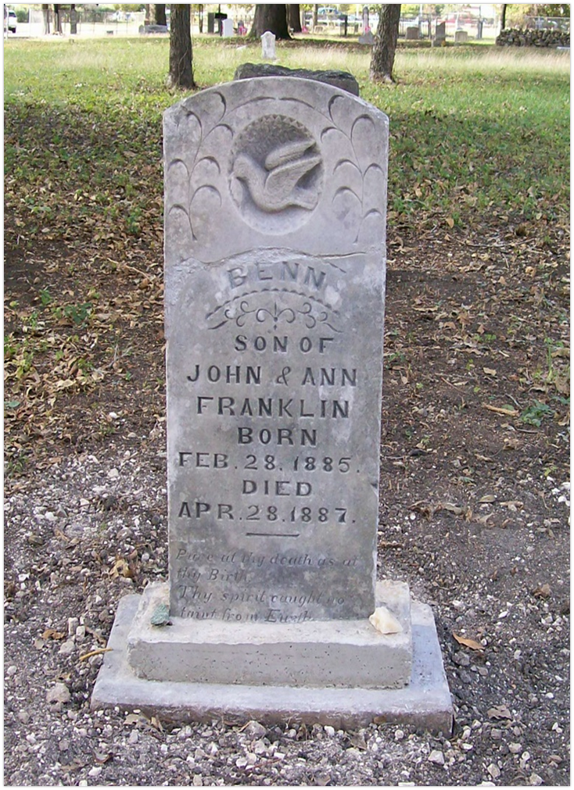
Analyze Benn’s Epitaph:
Pure at thy death as at Thy birth,
Thy spirit caught no taint from Earth
Notes:
Benn’s epitaph reads: “Pure at thy death as at Thy birth, Thy spirit caught no taint from Earth.” This refers to his young age, only 2 years old, and is actually a line from a poem.
Photo courtesy of Find a Grave.

Slide 17
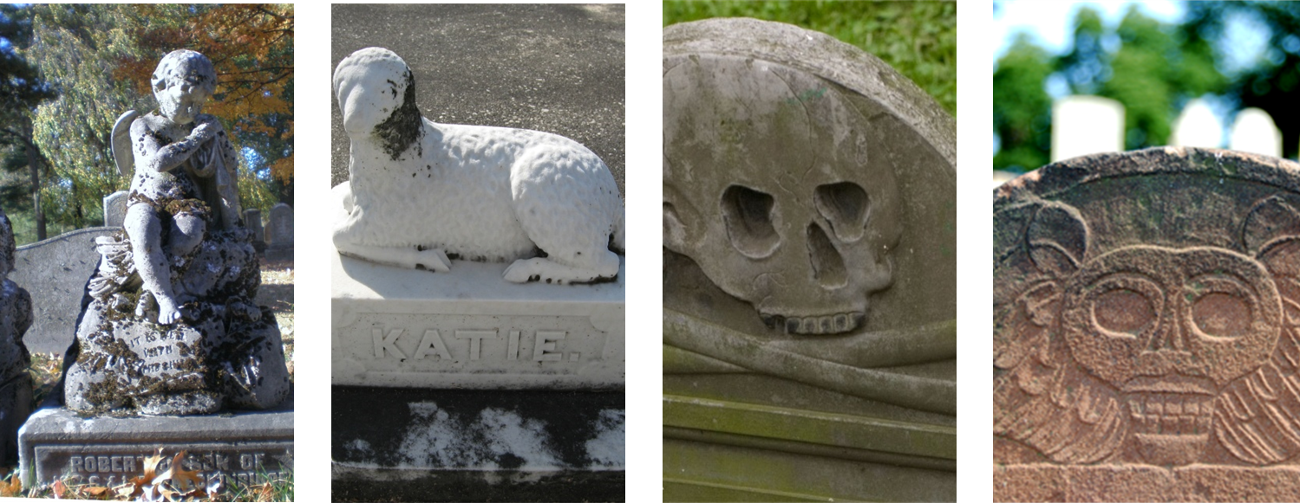
Step 2: Interpret the Symbols
Notes:
In addition to reading the writing, archaeologists can interpret the symbols on the markers, which provide clues to a person’s identity.
Photos courtesy of FPAN.

Slide 18
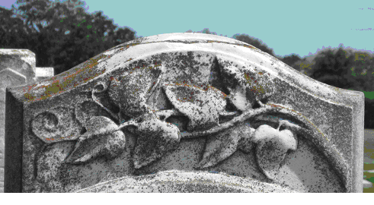
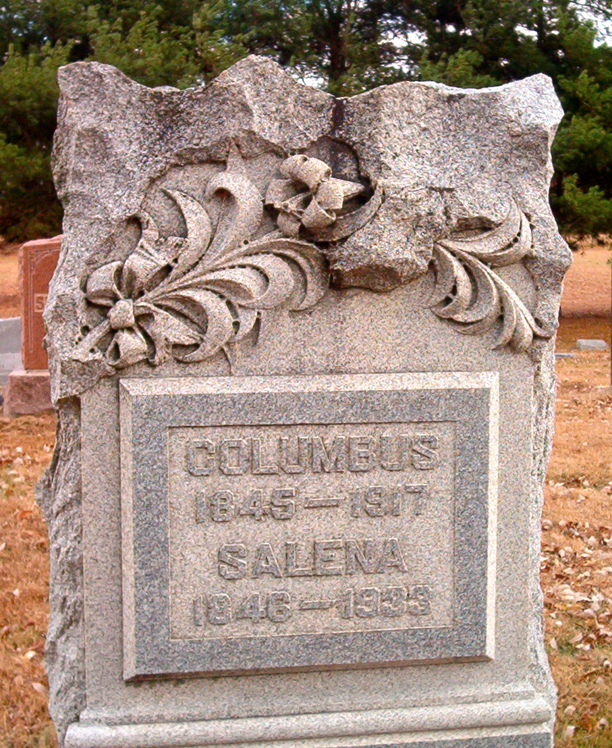
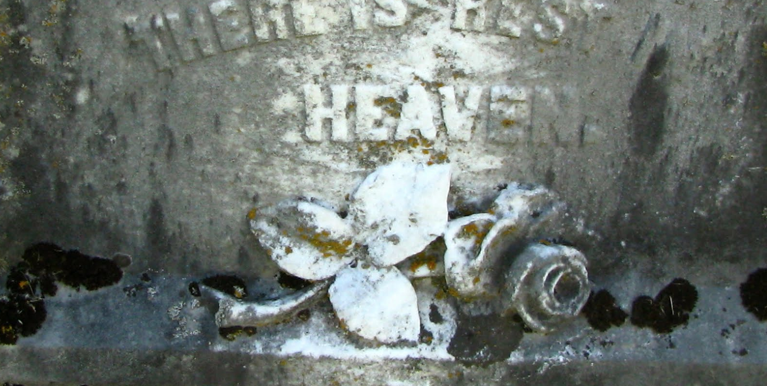
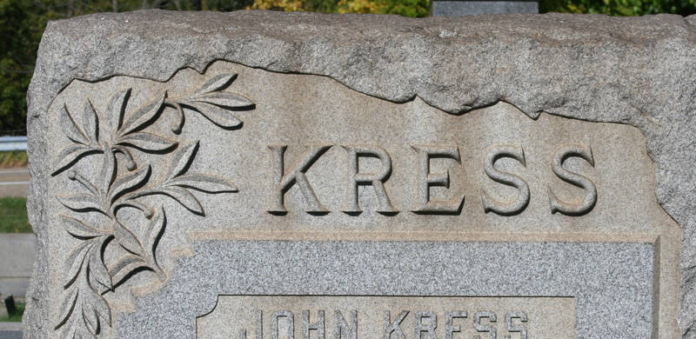
Common Symbols: Flowers
Interpreting Symbols: Plants
Ivy: Memory & Immortality
Lily: Purity & Resurrection
Rose: Love & Friendship
Olive Branch: Peace & Purity
Notes:
Photos courtesy of FPAN.

Slide 19
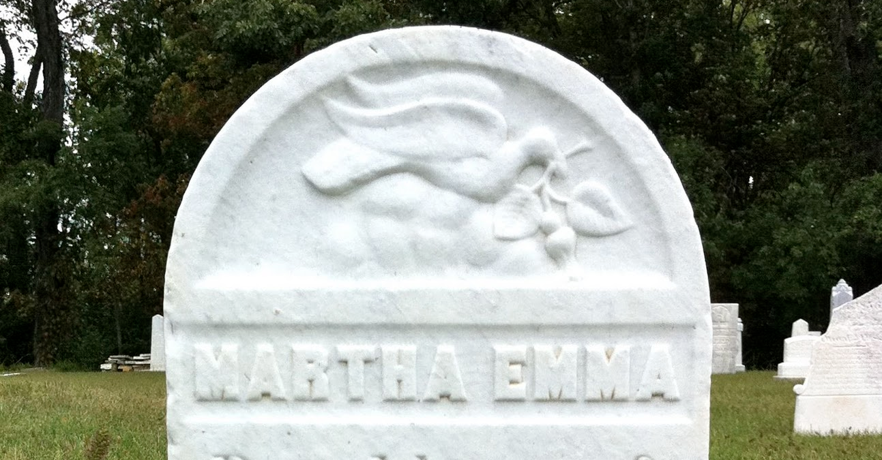
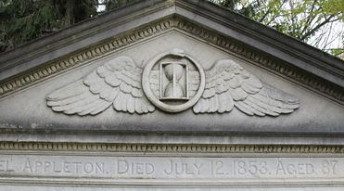
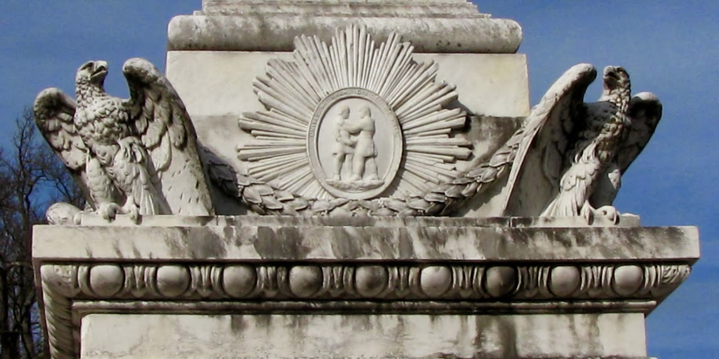
Common Symbols: Animals
Dove: Peace
Snake: Eternity
Eagle: Rebirth
Notes:
Photos courtesy of FPAN.

Slide 20
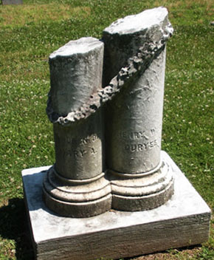
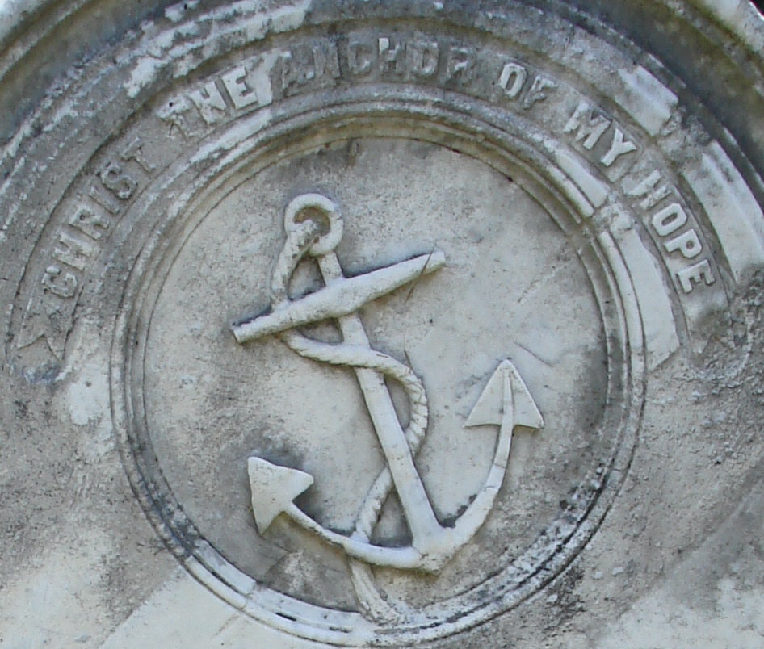
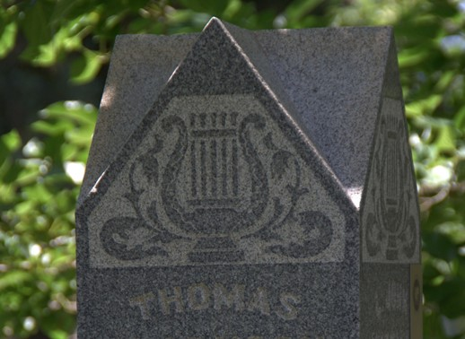
Common Symbols: Objects
Anchor: Hope & The Sea
Harp/Lyre: Music & Musician
Broken Column:
Life cut short
Notes:
These are a number of examples of symbols and their meanings.
Ask students: “Did you draw any symbols on your Final Resting Place? If so, why did you choose them? Do they have a deeper meaning? Would someone else be able to interpret the meaning?”
Photos courtesy of FPAN.

Slide 21
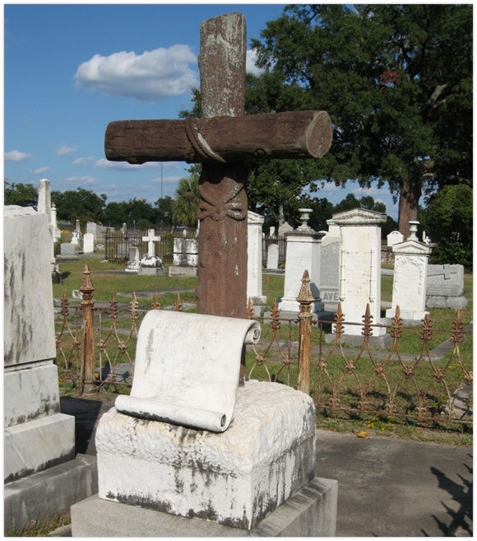
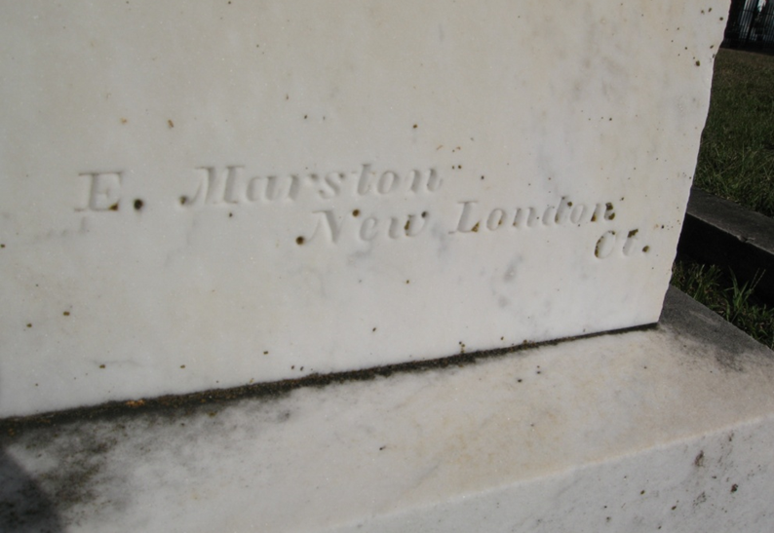
Step 3: Look For Clues in the Stone
Notes:
Finally, archaeologists look for clues in the actual stone. For example, stone carver might have hand-signed the marker, like in the one on the left. Archaeologists also examine the materials the marker is made of; especially here in Florida, where there isn’t much naturally occurring rocks, many materials were shipped long distances, indicating they were expensive
Photos courtesy of FPAN

Slide 22
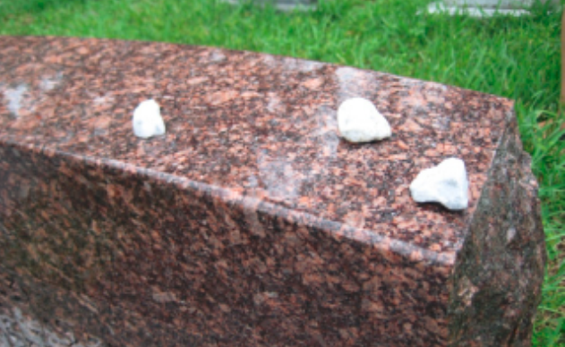
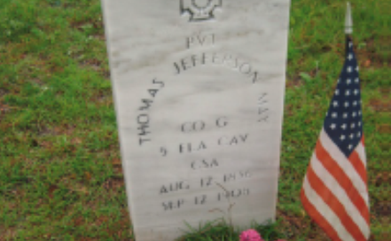
Grave Goods
Grave goods are anything left behind by those who visit the grave.
These items usually carry symbolic significance.
Notes:
Many times, items will be intentionally left at a marker to honor the person buried there. These are referred to as “grave goods.” Common grave goods include flowers, flags, shells, stones, and figurines. Sometimes, these items can provide insight into an individual’s social, ethnic, occupational, or religious affiliations.
Photos courtesy of FPAN.

Slide 23
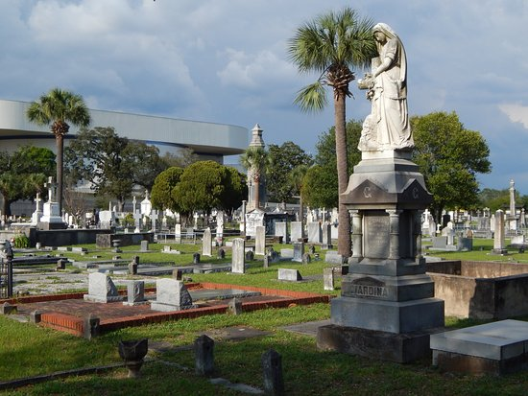
Overall Context
How old is the cemetery?
Are there any patterns?
How does each marker compare to the surrounding burials?
Notes:
Archaeologists also look at the overall context of the cemetery to understand each grave as a part of a larger whole. How old is the cemetery? Are there any patterns in the burials? How does this individual marker compare to surrounding burials?
By looking at the entire cemetery, we can better understand an entire community and how it changed throughout history.
Photo of St. Michael’s Cemetery courtesy of Trip Advisor.

Slide 24
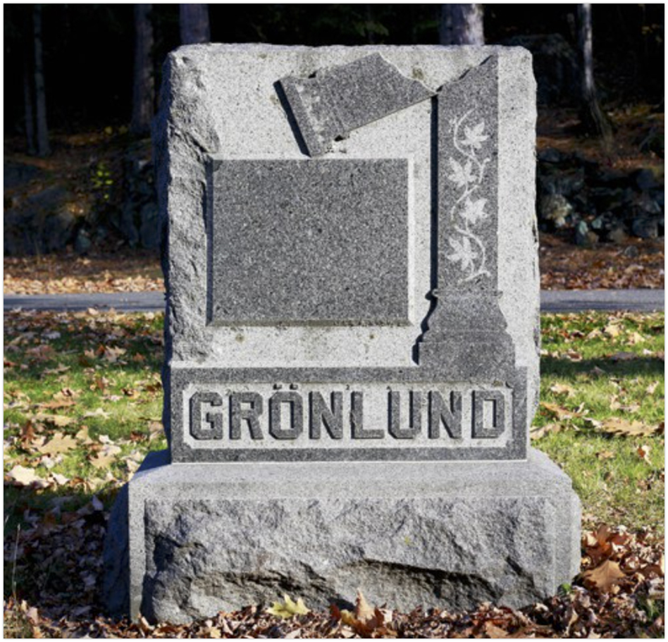
Notes:
Now we’ll look at a few markers to practice our new skills. This marker has a last name, but no birth or death dates. Can we learn anything from the symbol? Students should respond that the broken column represents life cut short, so the person buried here was likely young.
Photo courtesy of www.zenithcity.com

Slide 25
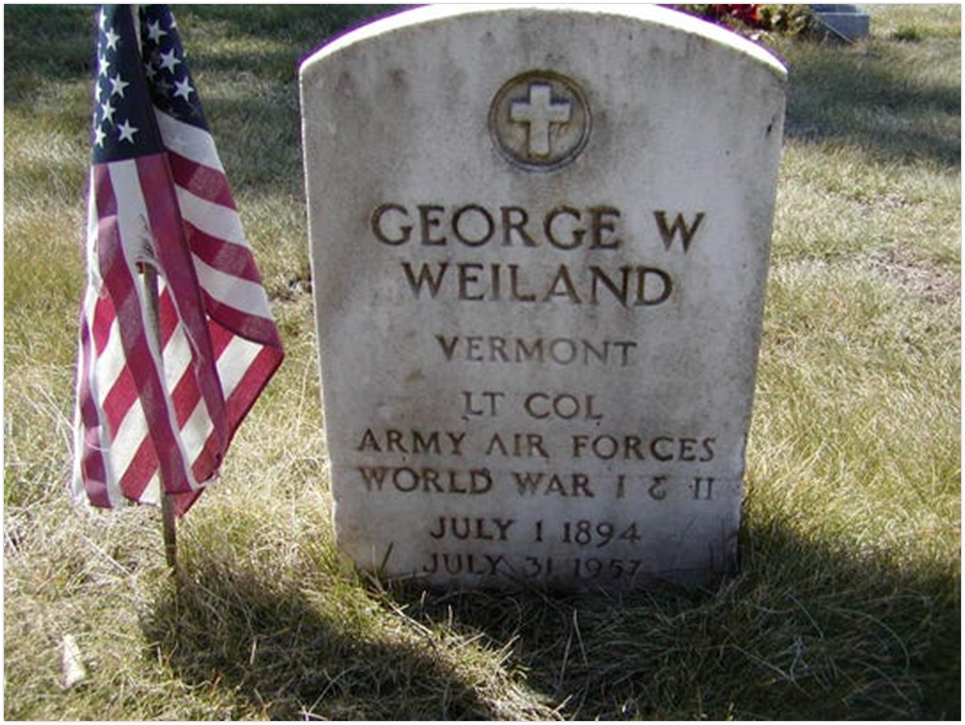
Notes:
What can we learn from this marker? Students should answer with name (George Weiland), home state (Vermont), rank (Lieutenant Colonel), military branch (Army Air Forces), wars served in (World War I and II), birth date (July 1, 1894), death date (July 31, 1957), and age (63). They might also point out the flag represents his veteran status, the marker is government issue, and the cross indicates he is Christian.
Image courtesy of Burlington Free Press.

Slide 26
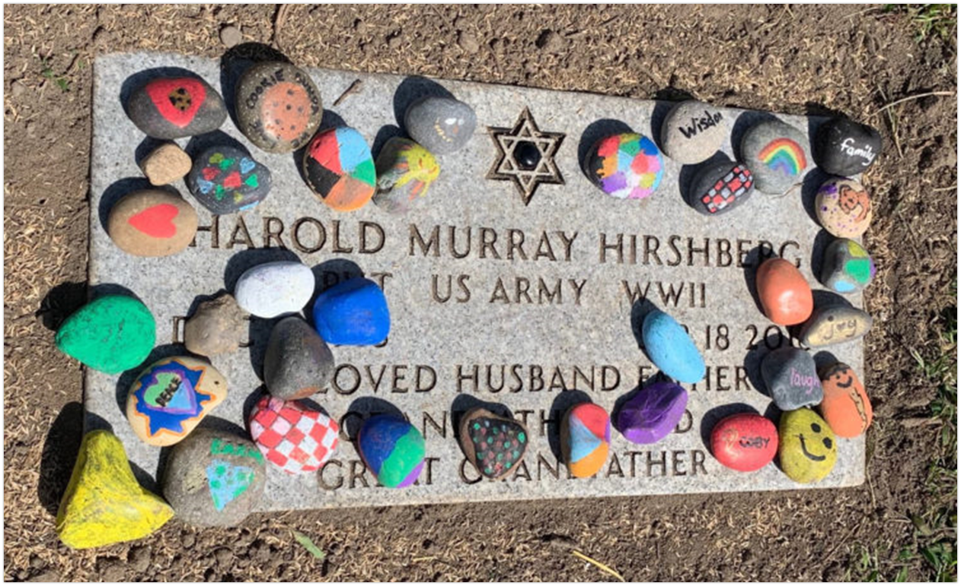
Notes:
What can we learn from this marker? Students should answer with name (Harold Murray Hirshberg), rank (private), military branch (army), war served in (WWII), was a husband, father, grandfather, and great-grandfather, and the star indicates he is Jewish.
Photo courtesy of the Arizona Jewish Post.
Leaving stones on cemetery markers is a Jewish tradition. There are different interpretations of this practice, but it is generally meant to symbolize the person’s continued memory after their death.
Compare this marker to the previous one. They are both government issue veteran markers, but the cross commonly found on these markers is replaced with the Jewish star on the second marker.

Slide 27
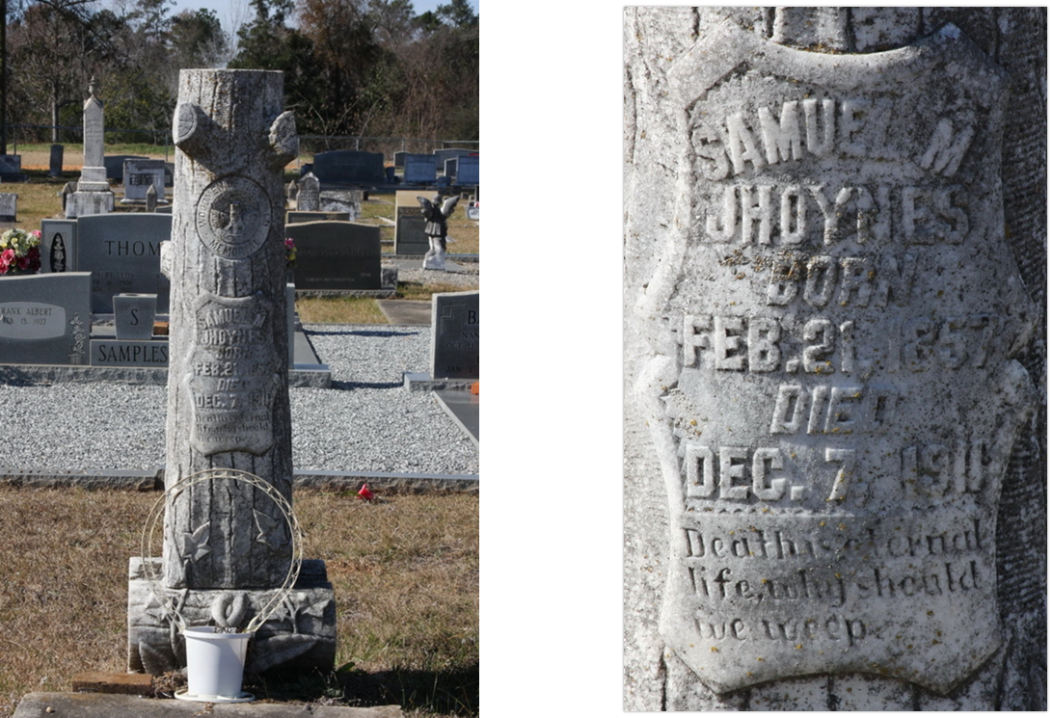
Notes:
What can we learn from this marker? Students should answer name (Samuel Joynes), birth date (February 21, 1857), death date (December 7, 1911), and age (54). They might also refer to the epitaph, which reads: Death is eternal life, why should we weep. This indicates his belief in the afterlife and a positive view of death.
This marker is in the shape of a tree trunk and indicates Samuel Jhoynes belonged to Woodmen of the World, a fraternal order founded in 1890 that provided life insurance to its members. Members of Woodmen of the World received these distinctive grave markers.
Photos courtesy of Find a Grave.

Slide 28
Recording Transcriptions
Copy the inscription EXACTLY as it is written on the stone. Include all misspellings and reversals.
  Copy uppercase as UPPERCASE and lowercase as lowercase.
  Copy all punctuation, even if it looks wrong to you.
Use a slash “/” to indicate a new line of text.
NEVER guess what a word, letter, or number is. If you don’t know, leave a blank space: “_____”
Notes:
One of the most important fields on the Headstone Recording form is the inscription. There is a specific way to record inscriptions to keep these forms consistent.
1. Copy the inscription EXACTLY as it is written on the stone. Include all misspellings and reversals. Copy uppercase as UPPERCASE and lowercase as lowercase. Copy all punctuation, even if it looks wrong to you.
2. Use a slash “/” to indicate a new line of text.
3. NEVER guess what a word, letter, or number is. If you don’t know, leave a blank space: “_____”

Slide 29
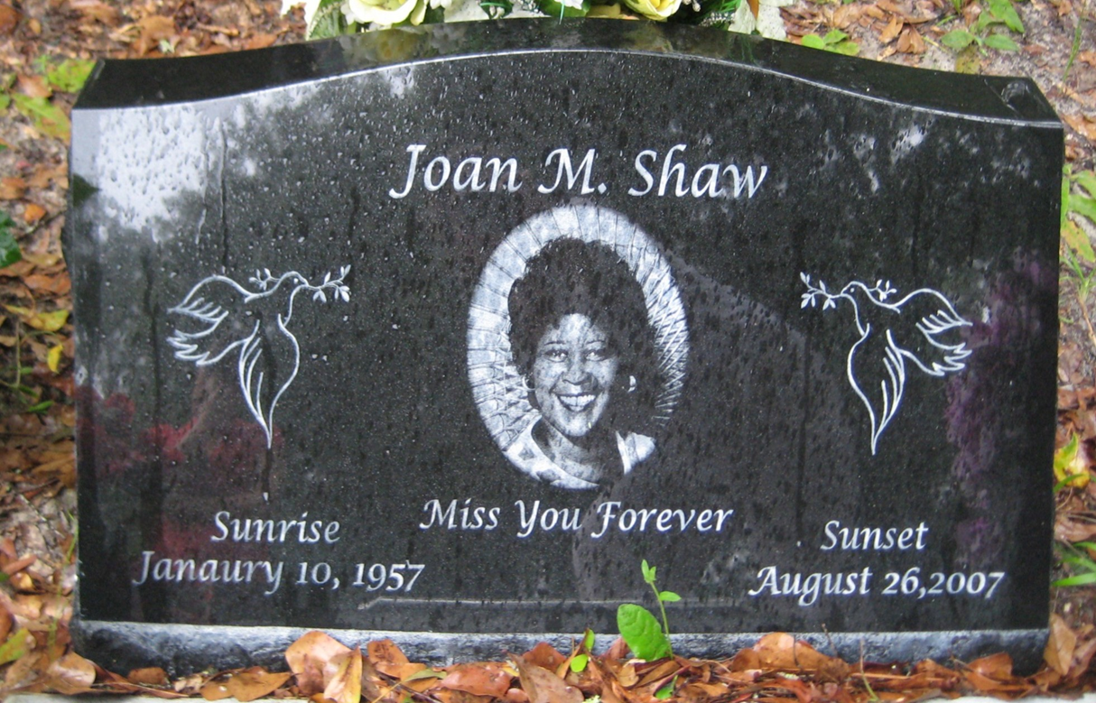
Notes:
Practice writing this transcription. Have students fill write the transcription on scratch paper, on the board, or on a headstone recording form.
Photo courtesy of FPAN.

Slide 30
Joan M. Shaw/Miss You Forever/Sunrise/Janaury 10, 1957/Sunset/August 26,2007
Notes:
This is what the transcription should look like. Note: January is misspelled on the headstone, so it is misspelled in the transcription.
Photo courtesy of FPAN.

Slide 31
FPAN/Florida Historic Cemetery Recording Project
Project # | Date (DD/MM/YY) |  |  |  | Surveyor Initials: |  | FS#
Cemetery Name: |  |  |  | GPS:
Section # |  | Row # |  | Grave # |  |  | Orientation (E/W or N/S, etc.):
Photo #’s
Inscription (use back for more space, indicate here if back is used)
Joan M. Shaw/Miss You Forever/Sunrise/Janaury 10, 1957/Sunset/August 26,2007
Type of Marker (check multiple if needed)
Above Ground Vault Cradle Government Issue Ground Marker |  |  | Handmade In-ground Vault Ledger Mausoleum |  |  |  |  | Metal Temporary Obelisk/Monolith Table Tomb x Upright Other:
Marker Material (check multiple if needed)
Concrete x Granite Limestone Marble |  |  | Metal/Aluminum Metal/Cast Iron Metal/Zinc Sandstone |  |  |  |  | Wood Other:
Material Notes (note kerbing, maker’s marks, footstone, etc.):
Gravestone Design/Iconography (ex. Dove, Tree, Cross, Star of David, etc.) |  |  |  |  |  | Sketch marker below, use metric scale
Two doves and an image of the deceased individual in the center of the marker
Grave Goods
Condition of Marker
X Good (minimal impacts, will last many years)
Fair (sinking, chipping, currently impacted)
Poor (at risk of loss in near future)
Additional Notes
Notes:
This is the headstone recording form, which we’ll use to record markers on our cemetery visit. In addition to recording the transcription, we will also record the marker type, the material, design elements, and the condition of the marker. Walk through these elements with the students. They can use the recording packet to learn more about marker types, symbols, and materials.

Slide 32
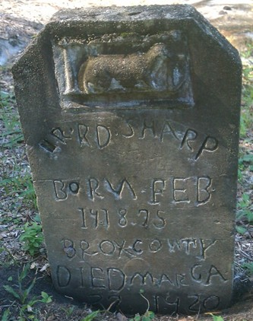
Notes:
Practice writing this transcription. Have students fill write the transcription on scratch paper, on the board, or on a headstone recording form.
Photo courtesy of FPAN.

Slide 33
_R/ RD SHARP/BORИ FEB/141875/BROX COWTY/ GA/DIED MAR 2_ 1920
Notes:
This is what the transcription should look like. Note: The backward “N” in “born” is drawn backward in the transcription.
Photo courtesy of FPAN.

Slide 34
FPAN/Florida Historic Cemetery Recording Project
Project # | Date (DD/MM/YY) |  |  |  | Surveyor Initials: |  | FS#
Cemetery Name: |  |  |  | GPS:
Section # |  | Row # |  | Grave # |  |  | Orientation (E/W or N/S, etc.):
Photo #’s
Inscription (use back for more space, indicate here if back is used)
_R/ RD SHARP/BORИ FEB/141875/BROX COWTY/ GA/DIED MAR 2_ 1920
Type of Marker (check multiple if needed)
Above Ground Vault Cradle Government Issue Ground Marker |  |  | Handmade In-ground Vault Ledger Mausoleum |  |  |  |  | Metal Temporary Obelisk/Monolith Table Tomb x Upright Other:
Marker Material (check multiple if needed)
x Concrete Granite Limestone Marble |  |  | Metal/Aluminum Metal/Cast Iron Metal/Zinc Sandstone |  |  |  |  | Wood Other stone: Other metal: Other:
Material Notes (note kerbing, maker’s marks, footstone, etc.):
Gravestone Design/Iconography (ex. Dove, Tree, Cross, Star of David, etc.) |  |  |  |  |  | Sketch marker below, use metric scale
Animal carved at top of marker
Grave Goods
Condition of Marker
Good (minimal impacts, will last many years)
X Fair (sinking, chipping, currently impacted)
Poor (at risk of loss in near future)
Additional Notes
Notes:
This is the completed headstone recording form. Walk through these elements with the students. They can use the recording packet to learn more about marker types, symbols, and materials.

Slide 35
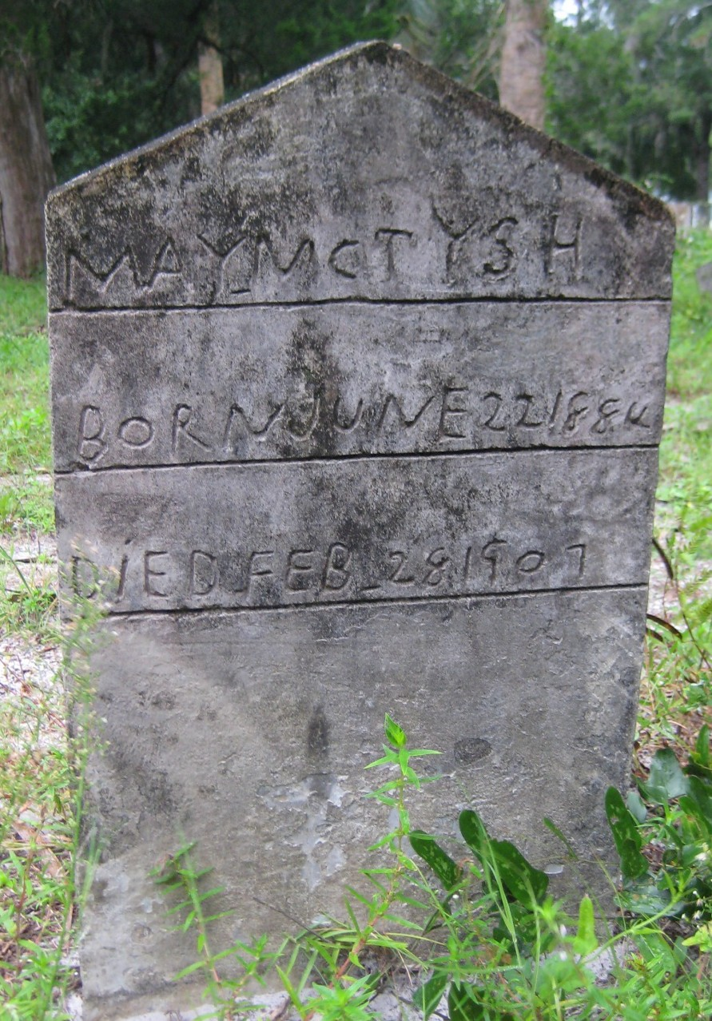
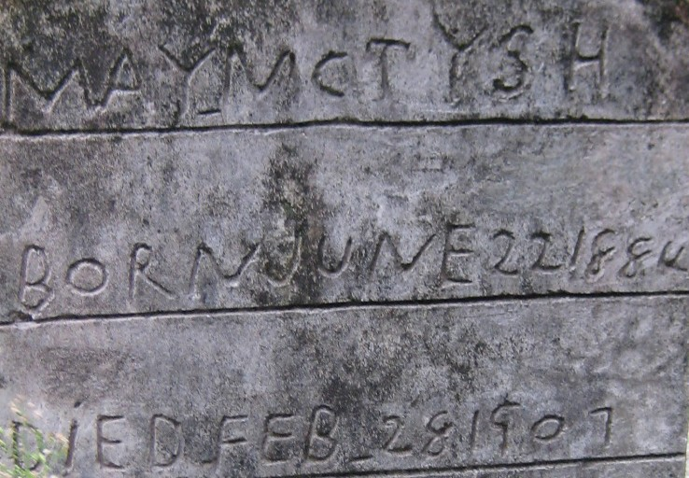
Notes:
Practice writing this transcription. Have students fill write the transcription on scratch paper, on the board, or on a headstone recording form.
Photo courtesy of FPAN.

Slide 36
MAY MCTY H/BORN JUNE 22 1884/DiED FEB 28 1907
Notes:
This is what the transcription should look like. Note: The lowercase “i” in “died” is written in lowercase in the transcription.
Photo courtesy of FPAN.

Slide 37
FPAN/Florida Historic Cemetery Recording Project
Project # | Date (DD/MM/YY) |  |  |  | Surveyor Initials: |  | FS#
Cemetery Name: |  |  |  | GPS:
Section # |  | Row # |  | Grave # |  |  | Orientation (E/W or N/S, etc.):
Photo #’s
Inscription (use back for more space, indicate here if back is used)
MAY MCTY__H/BORN JUNE 22 1884/DiED FEB 28 1907
Type of Marker (check multiple if needed)
Above Ground Vault Cradle Government Issue Ground Marker |  |  | Handmade In-ground Vault Ledger Mausoleum |  |  |  |  | Metal Temporary Obelisk/Monolith Table Tomb x Upright Other:
Marker Material (check multiple if needed)
x Concrete Granite Limestone Marble |  |  | Metal/Aluminum Metal/Cast Iron Metal/Zinc Sandstone |  |  |  |  | Wood Other stone: Other metal: Other:
Material Notes (note kerbing, maker’s marks, footstone, etc.):
Gravestone Design/Iconography (ex. Dove, Tree, Cross, Star of David, etc.) |  |  |  |  |  | Sketch marker below, use metric scale
None
Grave Goods
Condition of Marker
Good (minimal impacts, will last many years)
x Fair (sinking, chipping, currently impacted)
Poor (at risk of loss in near future)
Additional Notes
Notes:
This is the completed headstone recording form. Walk through these elements with the students. They can use the recording packet to learn more about marker types, symbols, and materials.

Slide 38
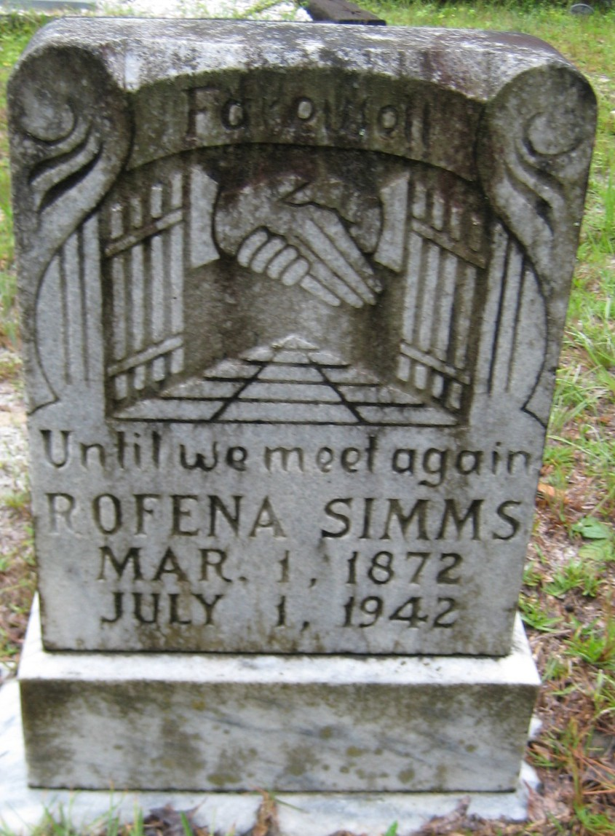
Notes:
Practice writing this transcription. Have students fill write the transcription on scratch paper, on the board, or on a headstone recording form.
Photo courtesy of FPAN.

Slide 39
Farewell/Until we meet again/ROFENA SIMMS/MAR. 1, 1872/JULY 1, 1942
Notes:
This is what the transcription should look like. Note: The difference between the lowercase and uppercase letters in the transcription.
Photo courtesy of FPAN.

Slide 40
FPAN/Florida Historic Cemetery Recording Project
Project # | Date (DD/MM/YY) |  |  |  | Surveyor Initials: |  | FS#
Cemetery Name: |  |  |  | GPS:
Section # |  | Row # |  | Grave # |  |  | Orientation (E/W or N/S, etc.):
Photo #’s
Inscription (use back for more space, indicate here if back is used)
Farewell/Until we meet again/ROFENA SIMMS/MAR. 1, 1872/JULY 1, 1942
Type of Marker (check multiple if needed)
Above Ground Vault Cradle Government Issue Ground Marker |  |  | Handmade In-ground Vault Ledger Mausoleum |  |  |  |  | Metal Temporary Obelisk/Monolith Table Tomb x Upright Other: Die on Base
Marker Material (check multiple if needed)
Concrete Granite Limestone x Marble |  |  | Metal/Aluminum Metal/Cast Iron Metal/Zinc Sandstone |  |  |  |  | Wood Other stone: Other metal: Other:
Material Notes (note kerbing, maker’s marks, footstone, etc.):
Gravestone Design/Iconography (ex. Dove, Tree, Cross, Star of David, etc.) |  |  |  |  |  | Sketch marker below, use metric scale
Clasping hands, opening doors
Grave Goods
Condition of Marker
x Good (minimal impacts, will last many years)
Fair (sinking, chipping, currently impacted)
Poor (at risk of loss in near future)
Additional Notes
Notes:
This is the completed headstone recording form. Walk through these elements with the students. They can use the recording packet to learn more about marker types, symbols, and materials.

